Slide 1
Croco2d Game Engine
github: https://github.com/alex-zhang/Croco-2DGameEngine
Alex Zhang

Slide 2
Before We Start

Slide 3
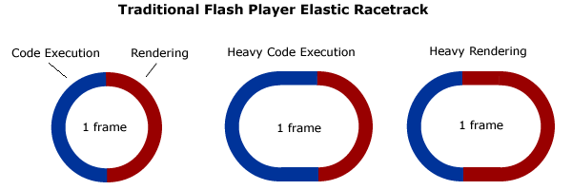
Flash Player Elastic Racetrack：
最早由Ted Patrick提出， 已得到官方的认可
http://tedpatrick.com/2005/07/19/flash-player-mental-model-the-elastic-racetrack/
Note： No ActionScript on the stack when rendering is in progress except BitmapData.draw, but rendering doesn’t call back to AS and AS waits the renderer to complete the operation

Slide 4
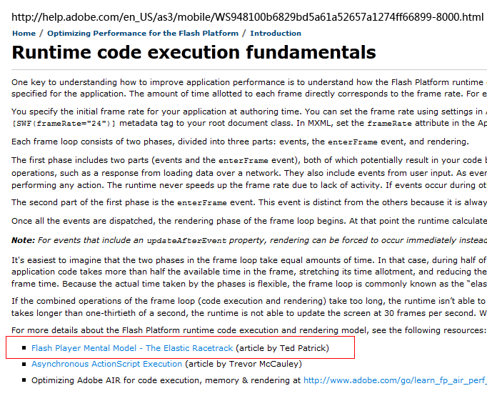
Flash Player Elastic Racetrack：

Slide 5
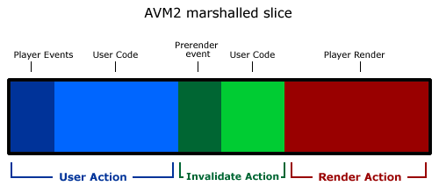
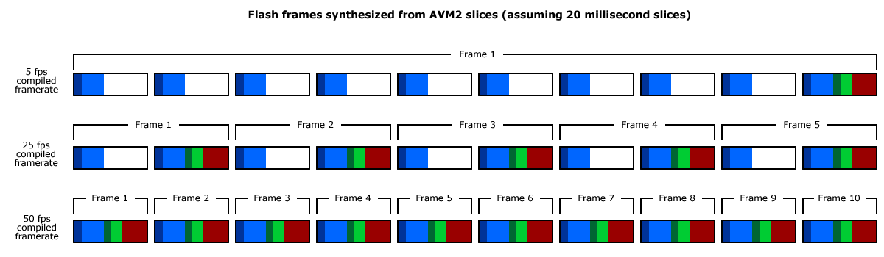
Flash Player Elastic Racetrack ： (Demo）
而Sean Christmann将这个理论进一步扩展成了“切片”模型
http://www.craftymind.com/2008/04/18/updated-elastic-racetrack-for-flash-9-and-avm2/
Demo: /可变跑道/...

Slide 6
Agenda
Stage3D-Starling
Entity-Component System
Croco2d Introduction

Slide 7
Starling
Principle.
Coordinate transformation.
Graphics rendering pipeline.
3D/2D Effect.
Starling-Framework code quick view.

Slide 8
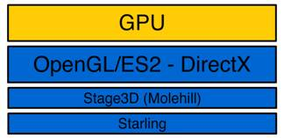
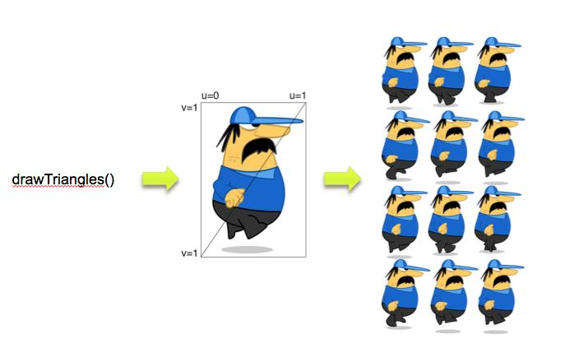
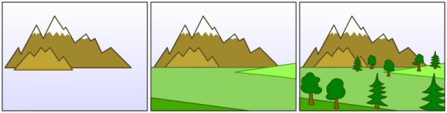
Starling-Principle

Slide 9
Starling – Coordinate Transform
Model Transformation.
link object coordinates to worldcoordinates.
…
3D Object
Container
Root Container
(3D Object)Matrix X (Parent)Matrix X …. = modelMatrix

Slide 10
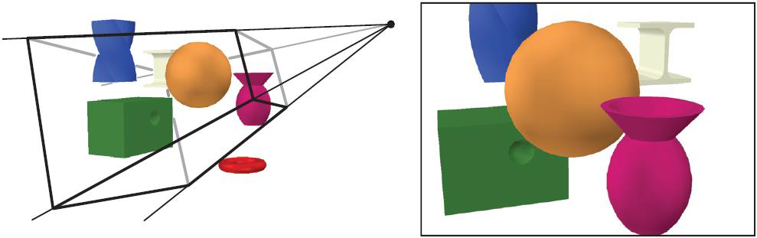
Starling – Coordinate Transform
View Transformation.
the eye/camera in worldcoordinates.
entire scene is transformed with the inverse view transform.
ModelMatrix X camera(eye)Matrix.inverse() = View(Screen)Matrix

Slide 11
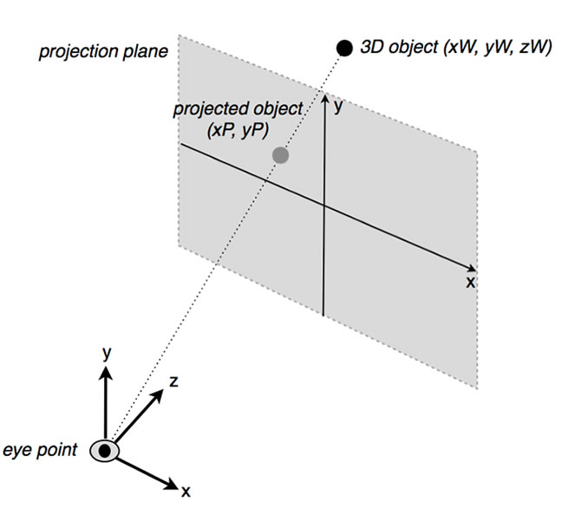
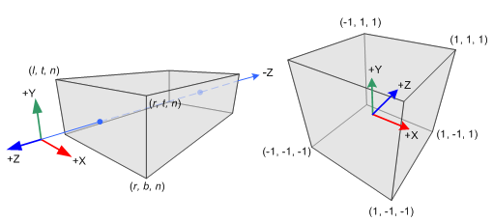
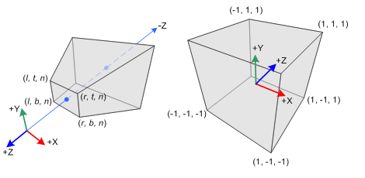
Starling – Coordinate Transform
Projection Transformation.
from view(screen) space to gpu space.
from n to (n-1) matrix transform algorithm.
finally the z range is between -1 and 1.
orthographic projection
Perspective projection

Slide 12
?

Slide 13
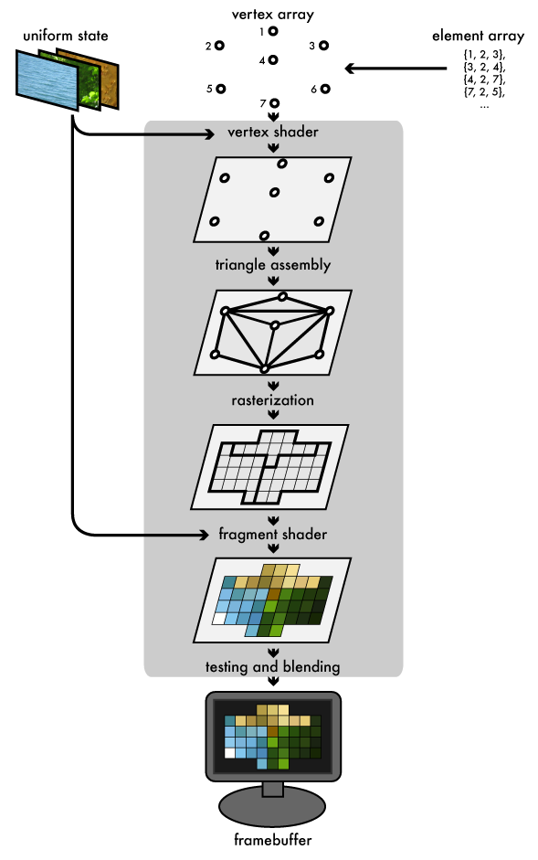
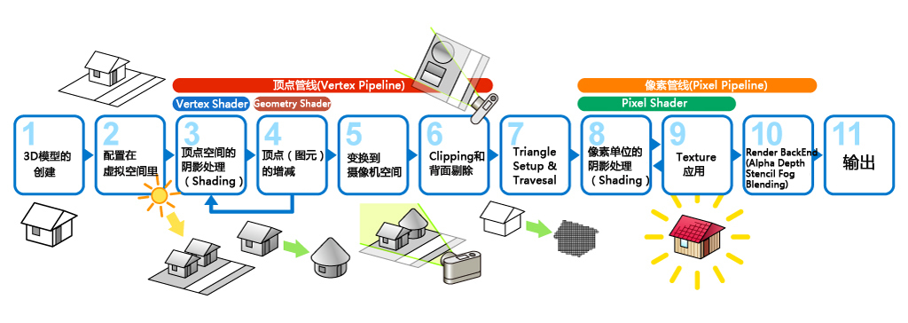
Starling - Graphics Pipeline

Slide 14
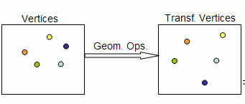
Starling - Graphics Pipeline
Step1: Input the Transformed Vertex data.
Vertex data includes Position, Normal, Color, UV and so on.
属性寄存器
这些寄存器引用作为顶点着色器输入的VertexBuffer的顶点属性数据。因此，它们仅可用于顶点着色器。
这是顶点着色器负责处理的主要数据流。VertexBuffer中的每个顶点属性拥有自己的属性寄存器。
要将一个VertexBuffer属性分配给特定的属性寄存器，Context3D:setVertexBufferAt() 和合适的索引。
然后从着色器，使用语法 va<n> 访问属性寄存器，其中 <n> 是属性寄存器的索引编号。
总共有8个属性寄存器可用于顶点着色器

Slide 15
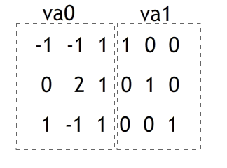
Starling - Graphics Pipeline
Step2: Vertex Shader.
m44 op,va0,vc0
mov v0,va1

Slide 16
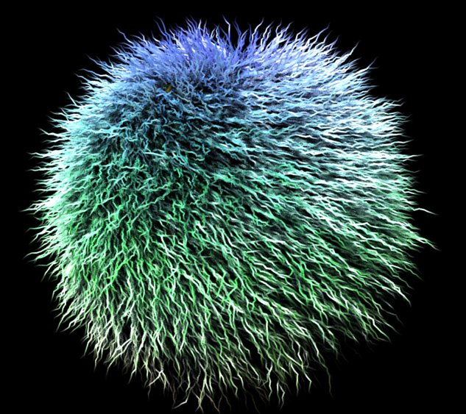
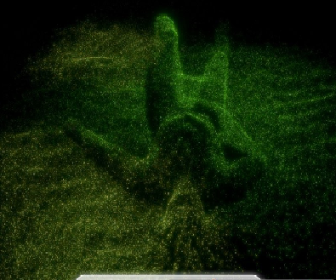
Starling - Graphics Pipeline
Step3: Geometry Shader.
Remove/add new Vertex.
DirectX 10.x, OpenGL 3.x Support (Shader Model 4（第四代显卡着色架构).

Slide 17
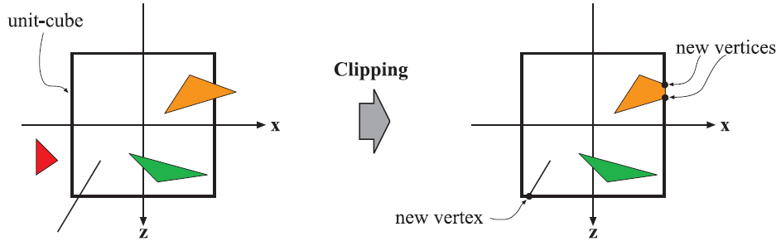
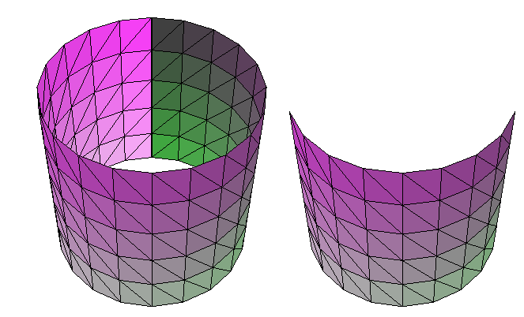
Starling - Graphics Pipeline
Step4:Vertex Clipping & BackFace Culling

Slide 18
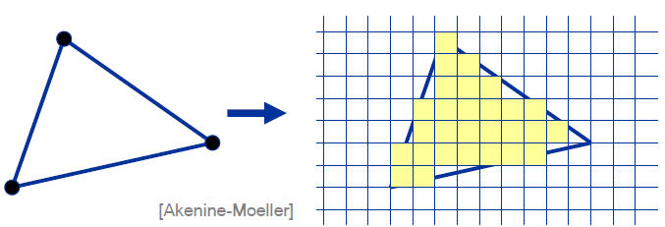
Starling - Graphics Pipeline
Step5:Rasterization

Slide 19
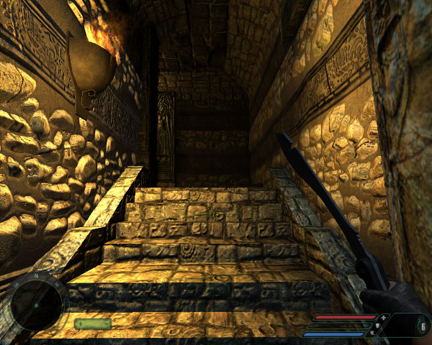

Starling - Graphics Pipeline
Step6:Input Texture & Pixel Shader

Slide 20
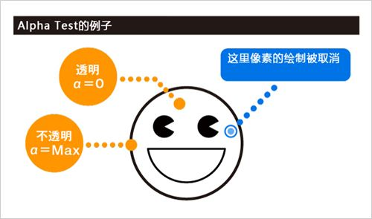
Starling - Graphics Pipeline
Step7:AlphaTest

Slide 21
Starling - Graphics Pipeline
Step8:DepthTest

Slide 22
Starling - Graphics Pipeline
Step9:AsciTest

Slide 23
Starling - Graphics Pipeline
Step10:AlphaBlending
Alpha Blending因为要将已经渲染的结果读出后，做进一步合成计算再绘制出来，所以绘制的负荷很高。

Slide 24
Starling–Framework code quick view (Code)
Codes in Starling.

Slide 25
?

Slide 26

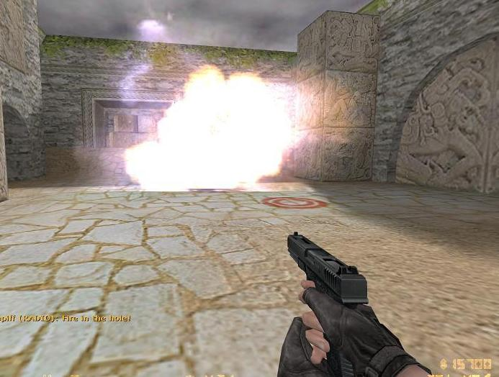
Starling-3D/2D Effect
Billboard(广告牌/公告板)

Slide 27
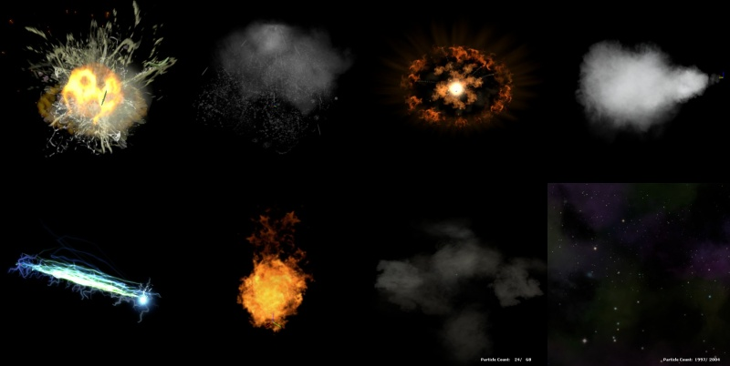
Starling-3D/2D Effect
Particle System

Slide 28
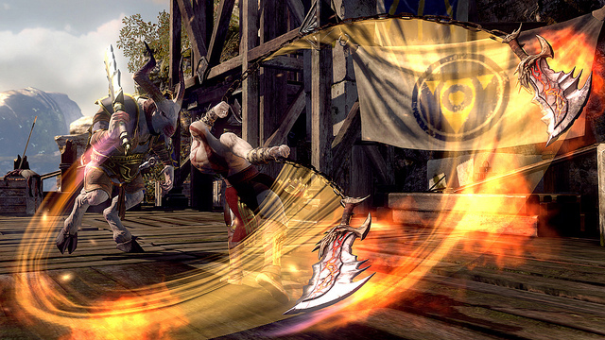
Starling-3D/2D Effect
Weapon Trail(Demo in Starling)
Demo: http://wiki.starling-framework.org/extensions/ribbontrail

Slide 29
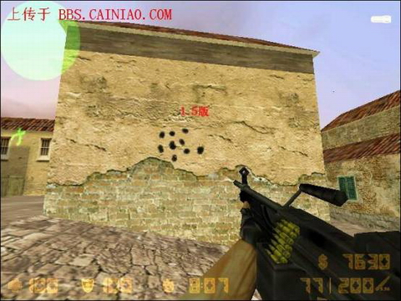
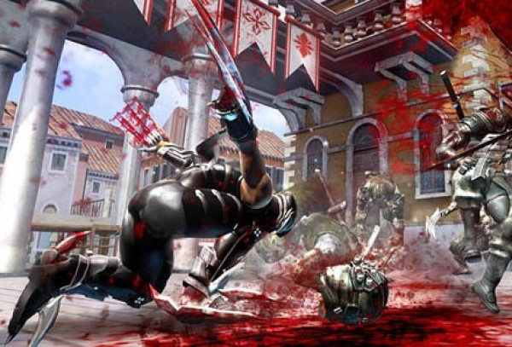
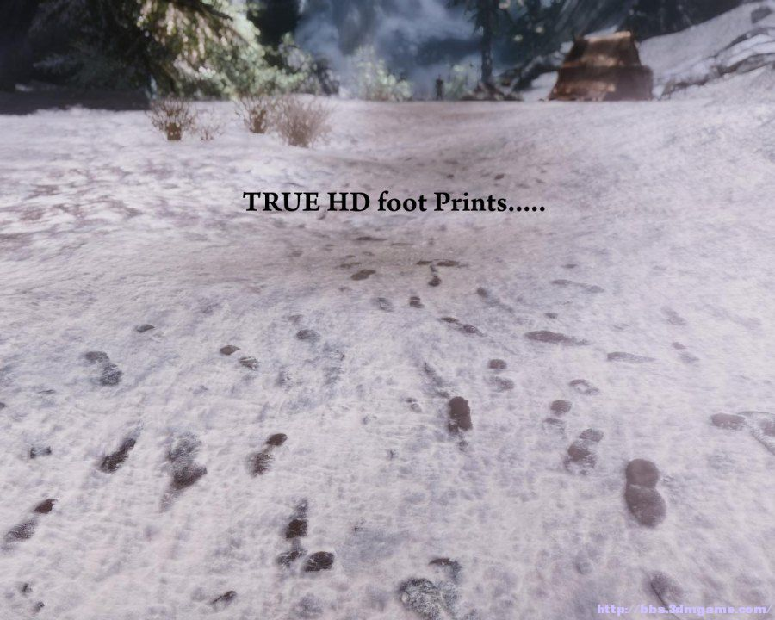
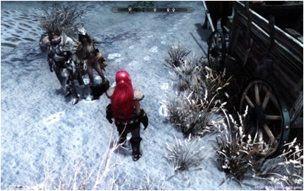
Starling-3D/2D Effect
Applique （贴花）

Slide 30
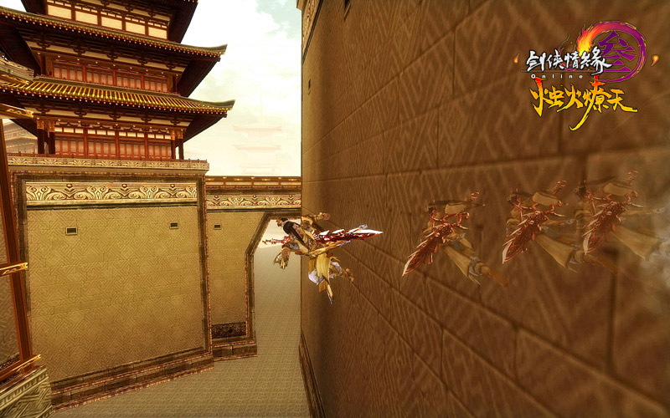
Starling-3D/2D Effect
残影/分身

Slide 31
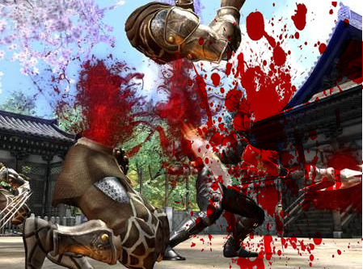
Starling-3D/2D Effect
Screen Effect (屏幕特效)

Slide 32
Starling-3D/2D Effect
http://chaimzane.iteye.com/admin/blogs/1868401

Slide 33
?

Slide 34
Entity-Component System

Slide 35
?

Slide 36
Engine Introduction

Slide 37
2D Scene(why 2d?).
Starling based.
Entity-Component architecture.
Rapid application development.

Slide 38
?

Slide 39
Links：
http://gaming.adobe.com
http://chaimzane.iteye.com/blog/1868401
http://duriansoftware.com/joe/An-intro-to-modern-OpenGL.-Chapter-1:-The-Graphics-Pipeline.html

Slide 40
END

